Slide 1
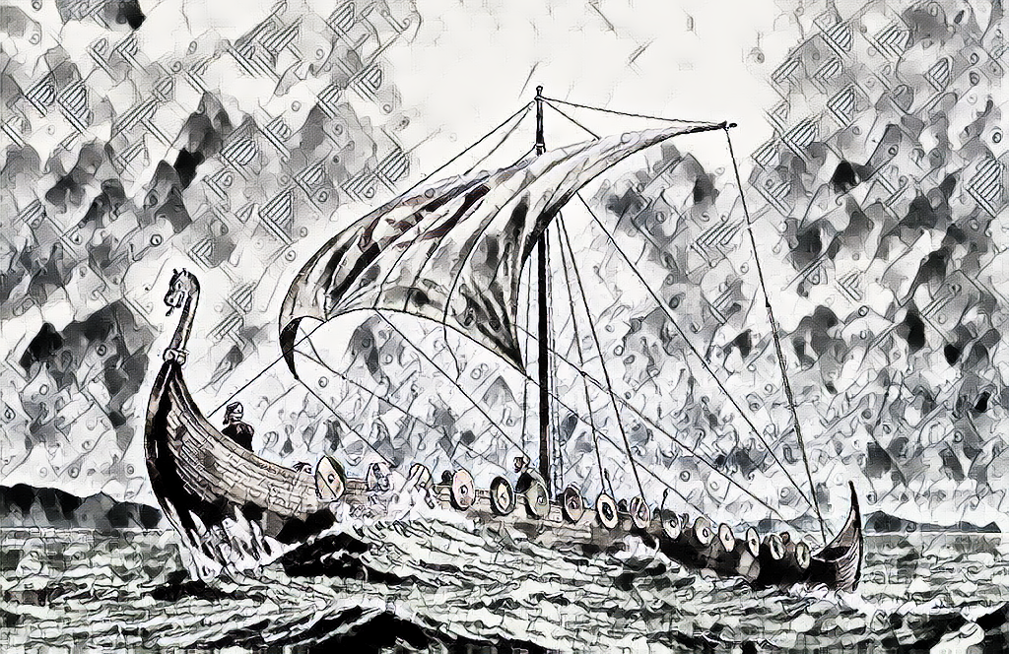
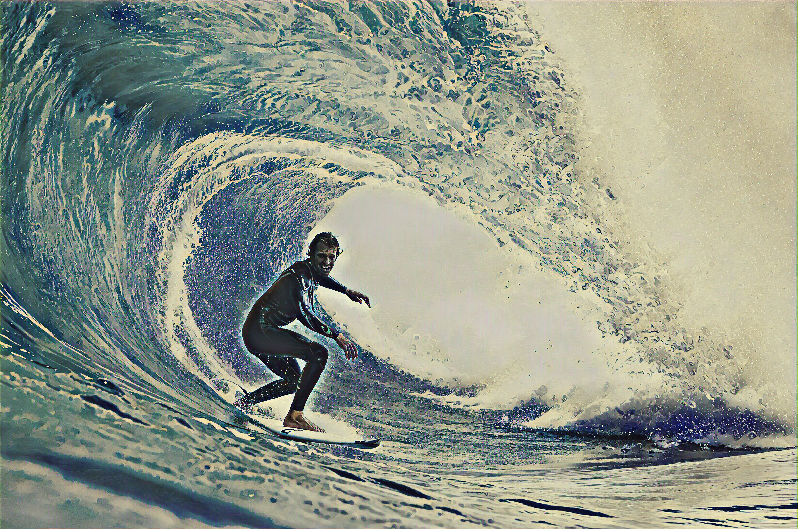
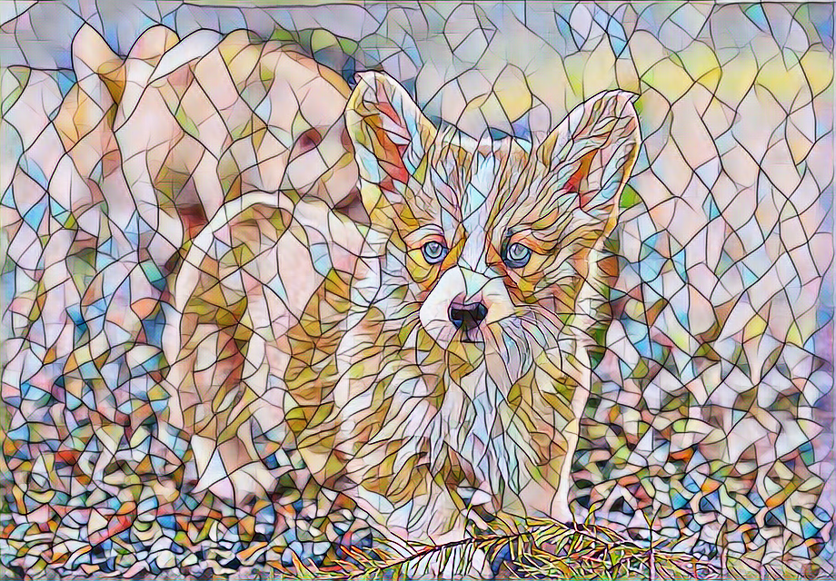
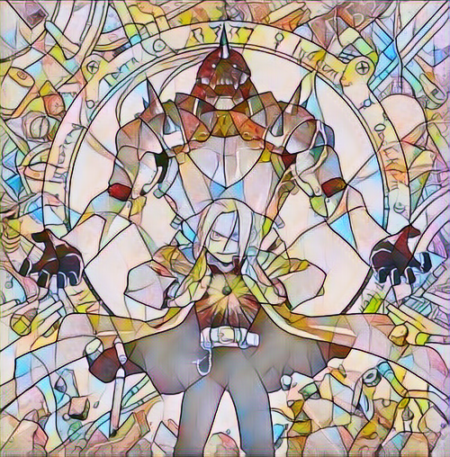
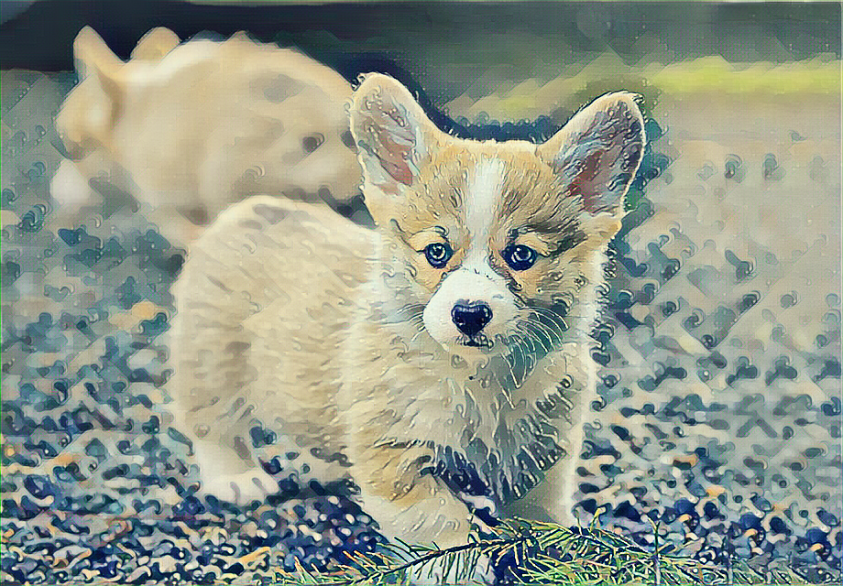
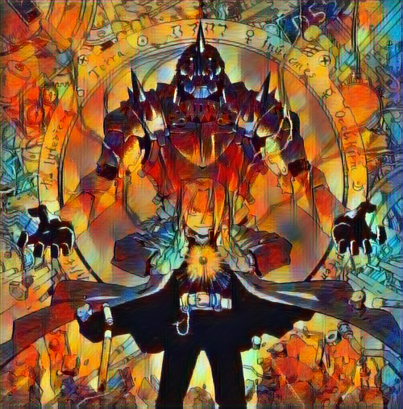
Style Transfer with Facial Preservation
Zachary Ferguson

Slide 2
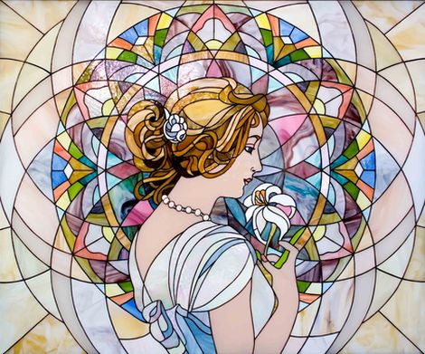
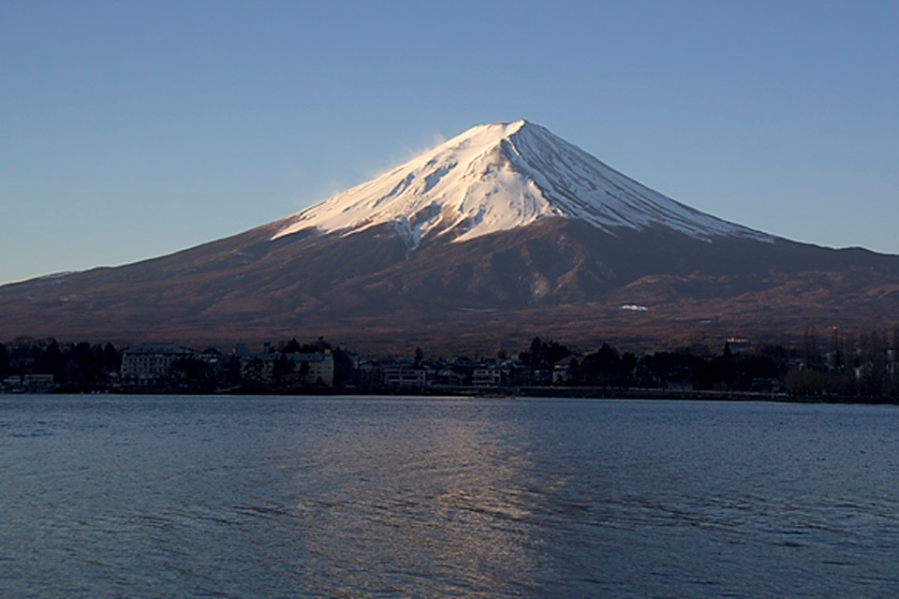
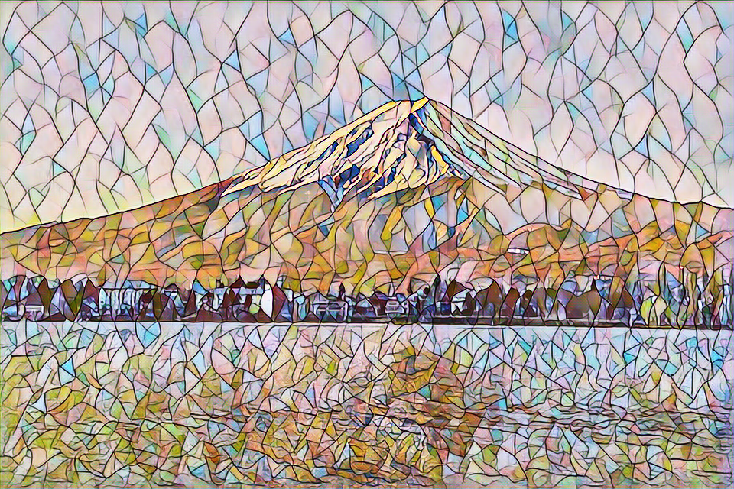
Style Transfer with Facial Preservation
Style Transfer:
Transfer the style from one image onto the content of another image
Our Goal:
Extend the standard style transfer methodology to accommodate target content preservation (faces to start with)
+
=

Slide 3
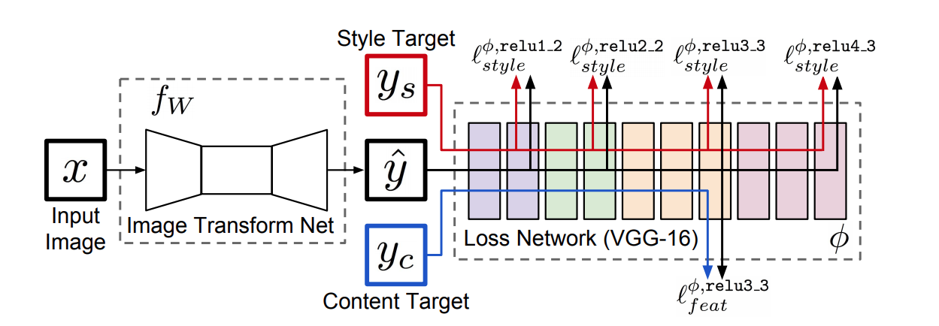
Fast Style Transfer (Johnson et al.)
Use perceptual loss to train an image transformation network to learn style transfer
Learn an image transformation network for a single style image

Slide 4
Perceptual Loss
Use a pretrained image classification network to quantify the perceptual difference of two images
Activation layers of a convolutional neural network contain a high level understanding of the
style (earlier layers)
content (later layers)

Slide 5
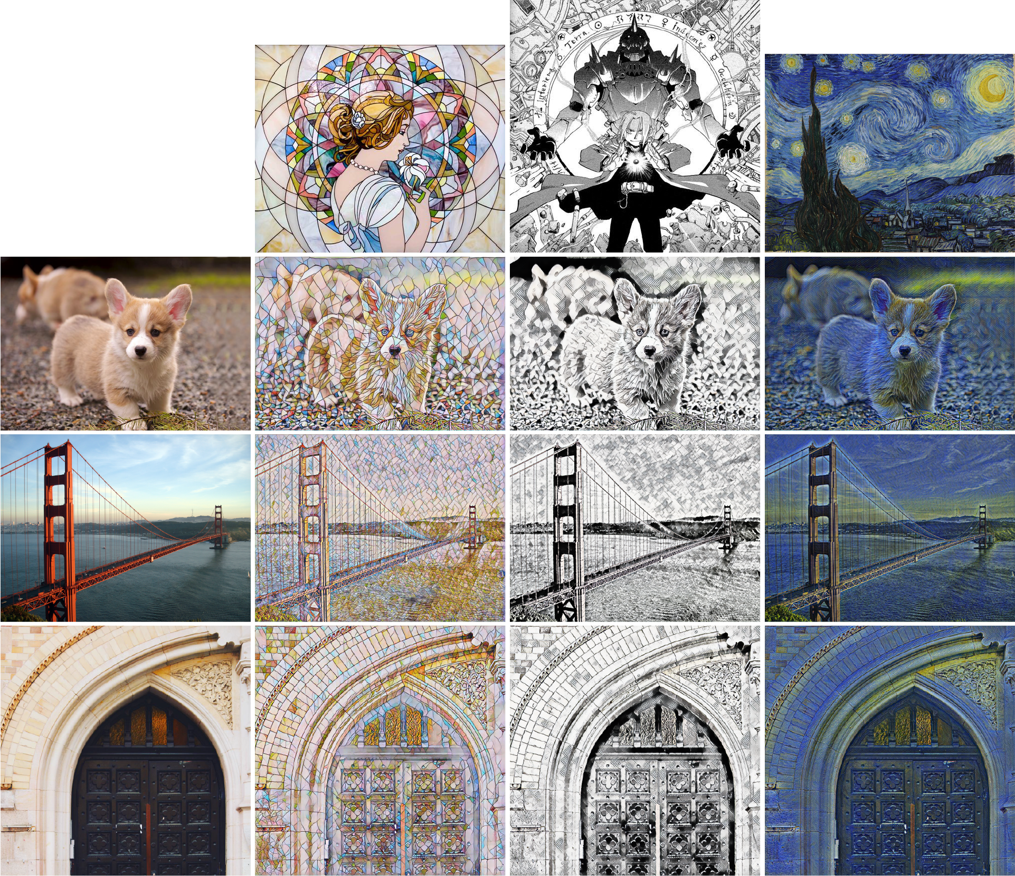

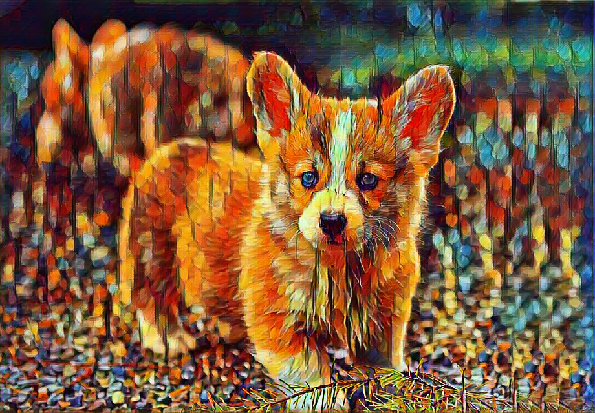
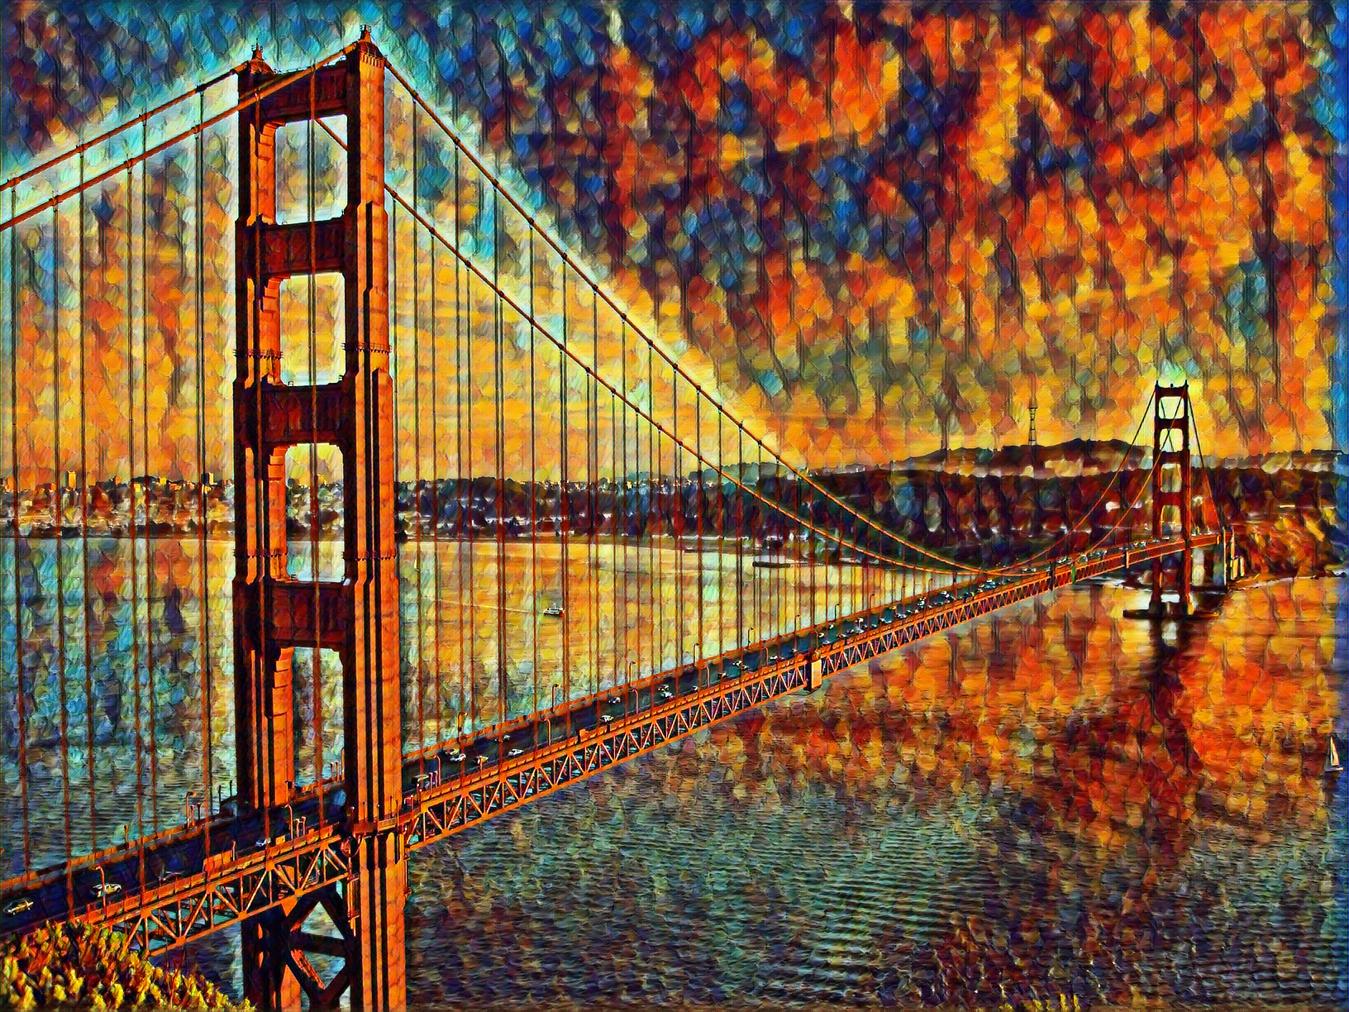
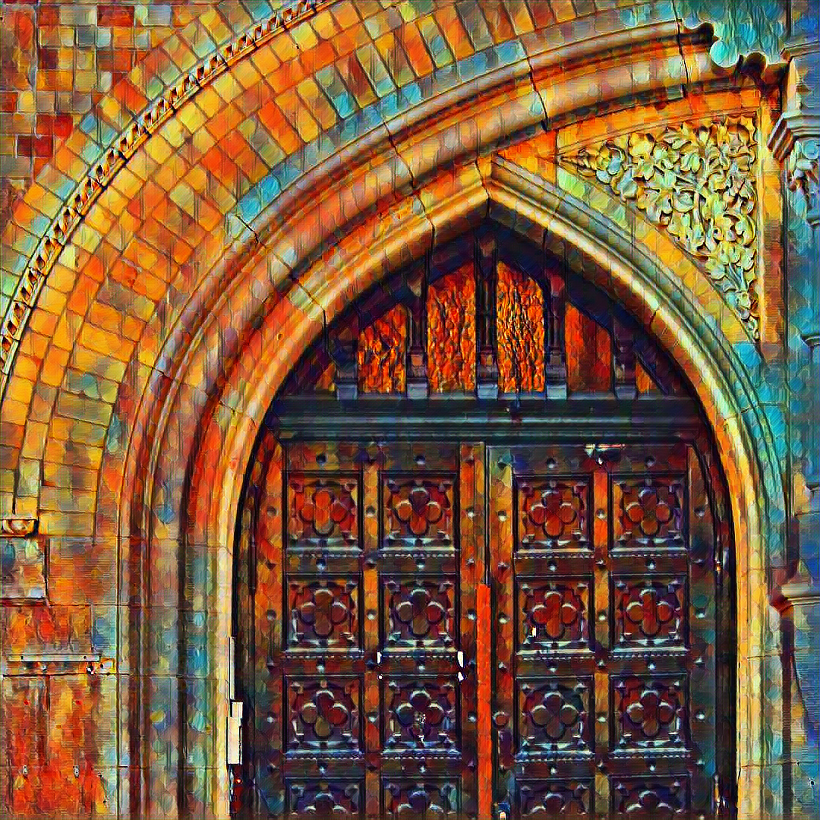
Results of Style Transfer
Style Images
Content Images

Slide 6
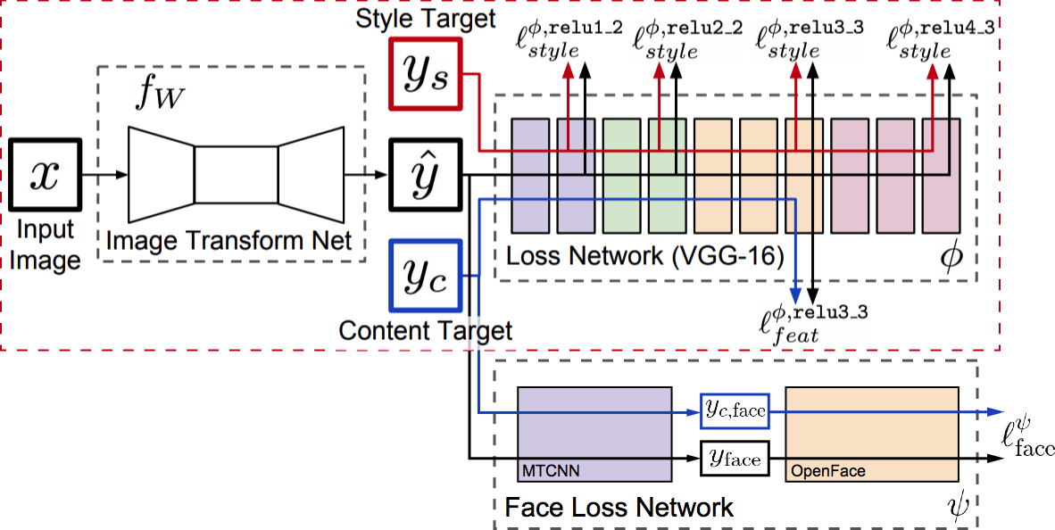
Extension: Face Loss
Use “Joint Face Detection and Alignment using Multi-task Cascaded Convolutional Networks” to find faces (Zhang et al. 2016)
Use OpenFace to compute a face descriptor (Amos et al. 2016)
The face loss is then the squared distance between descriptors of the face in the original image and the stylized image

Slide 7

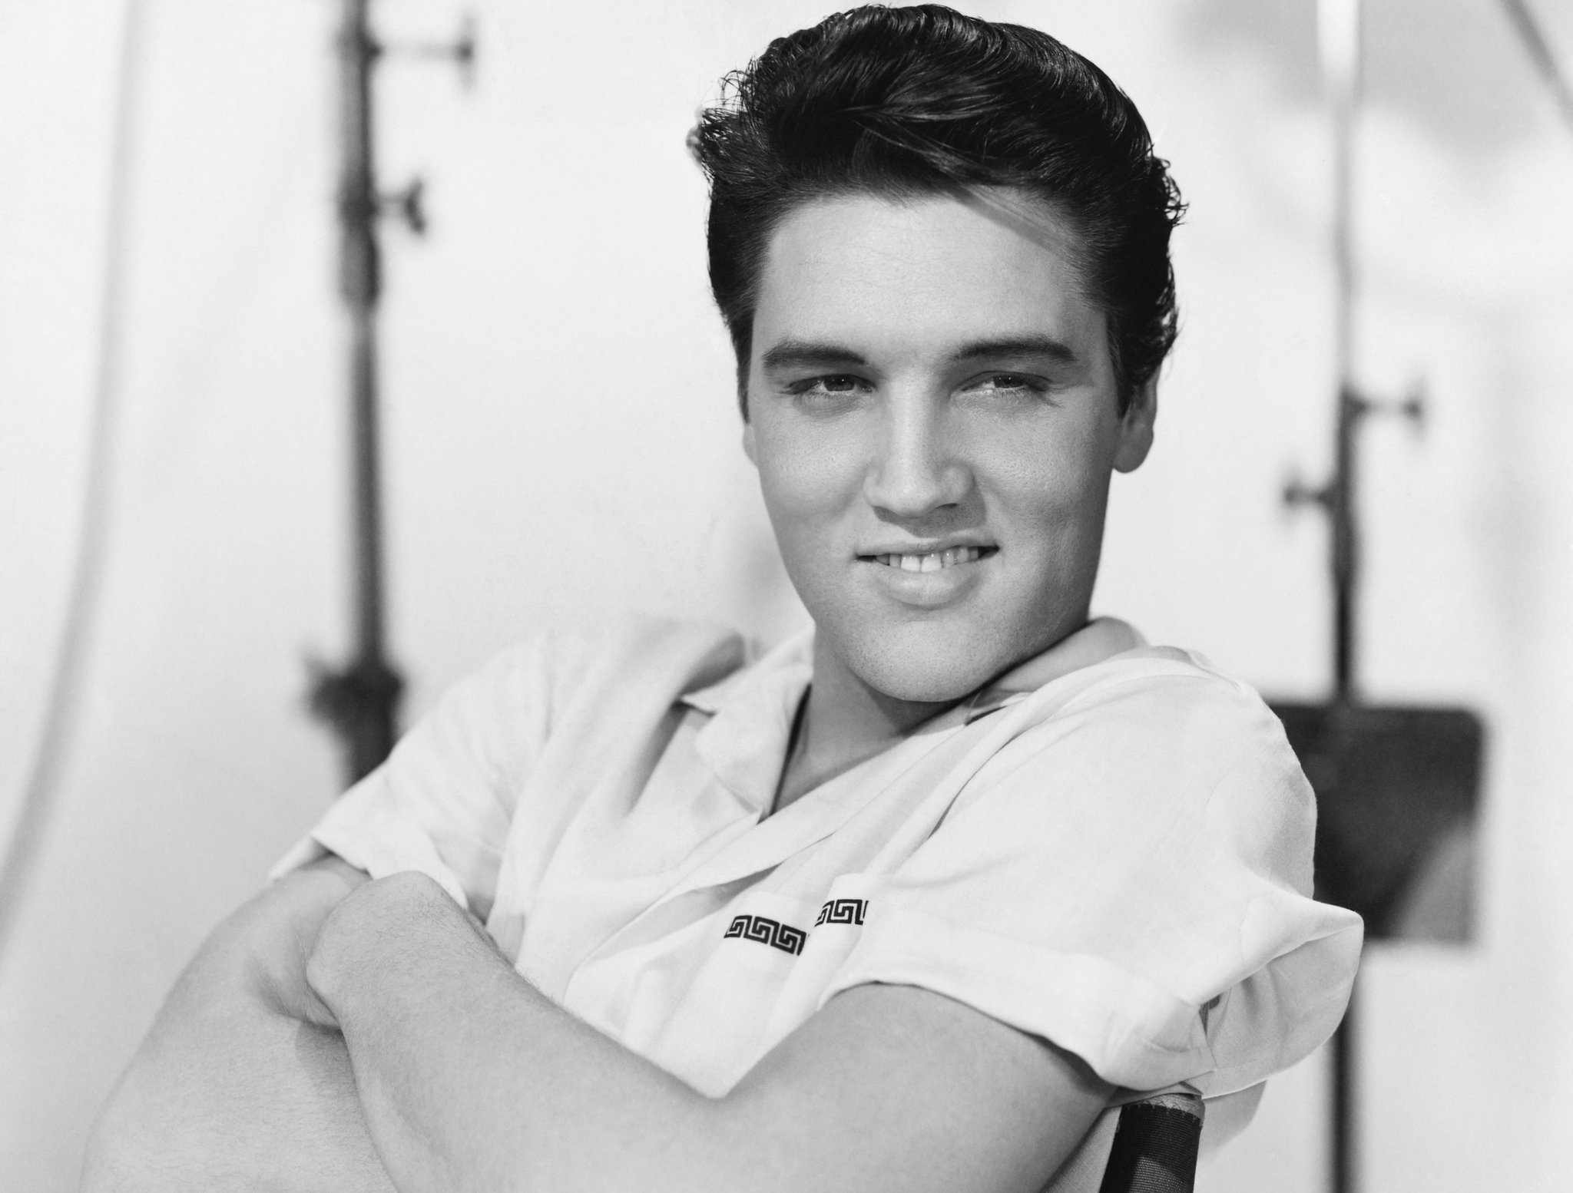
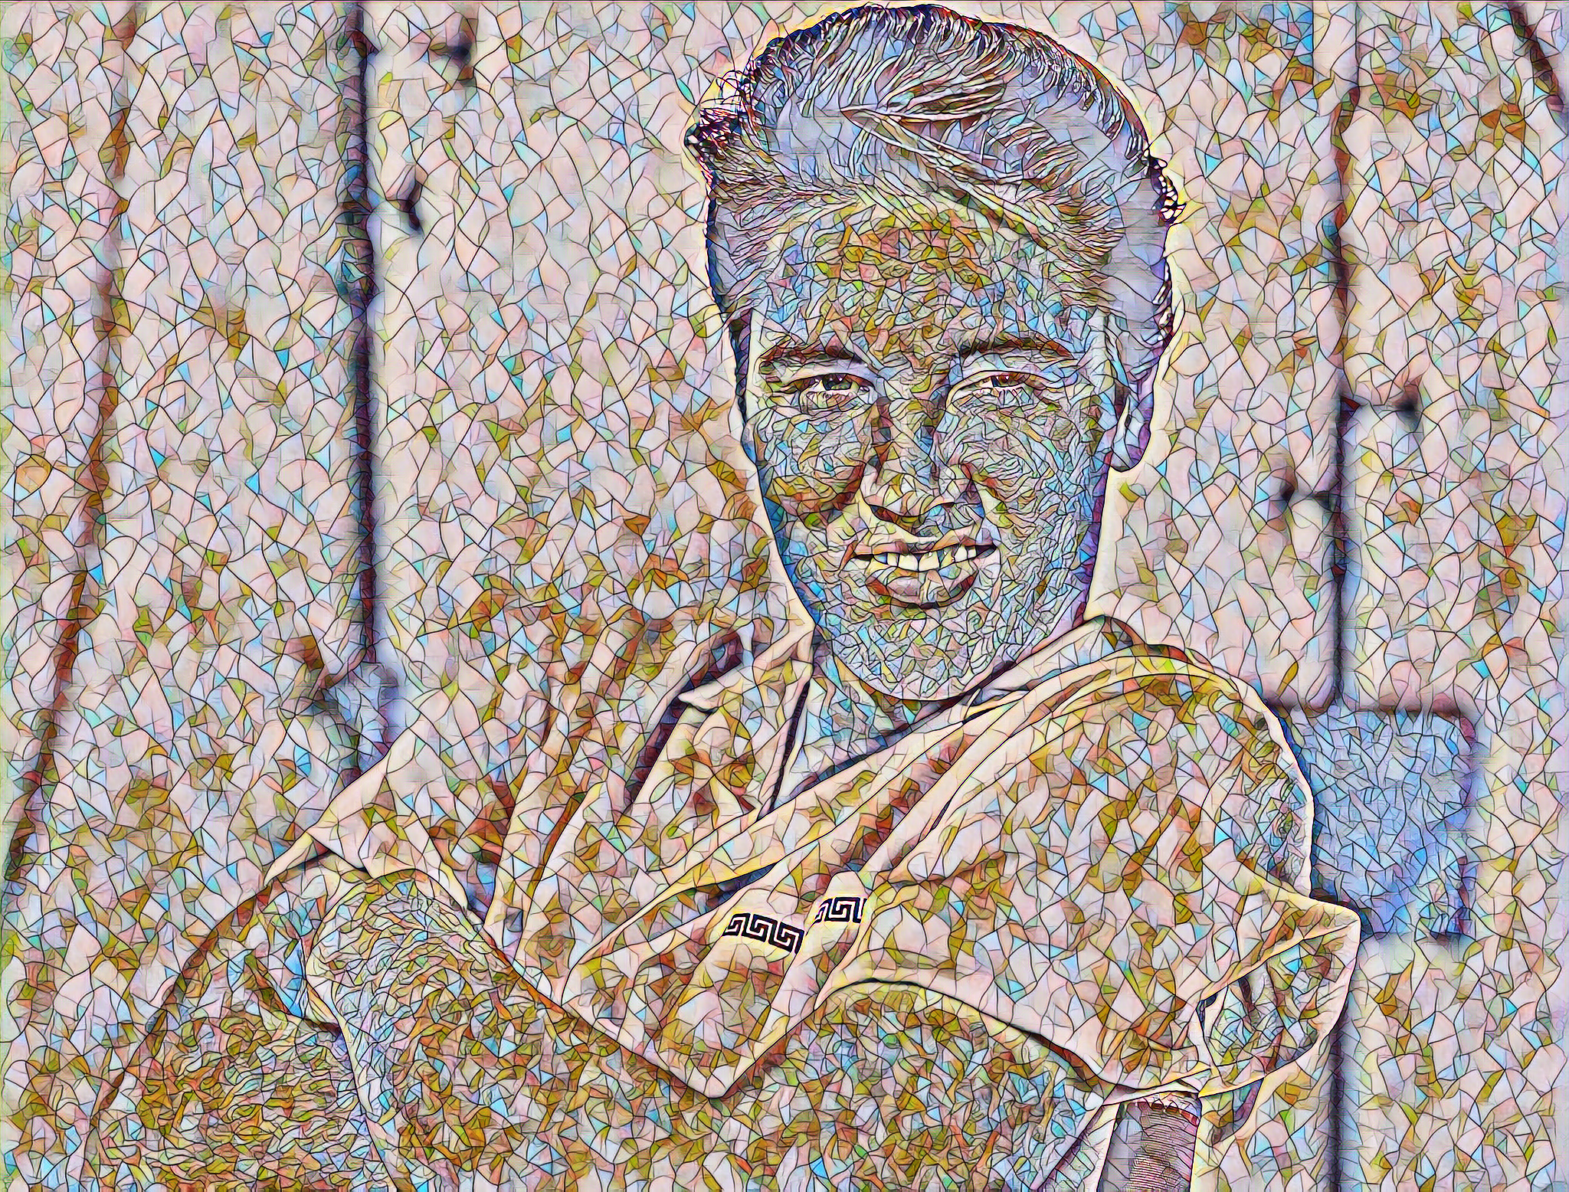
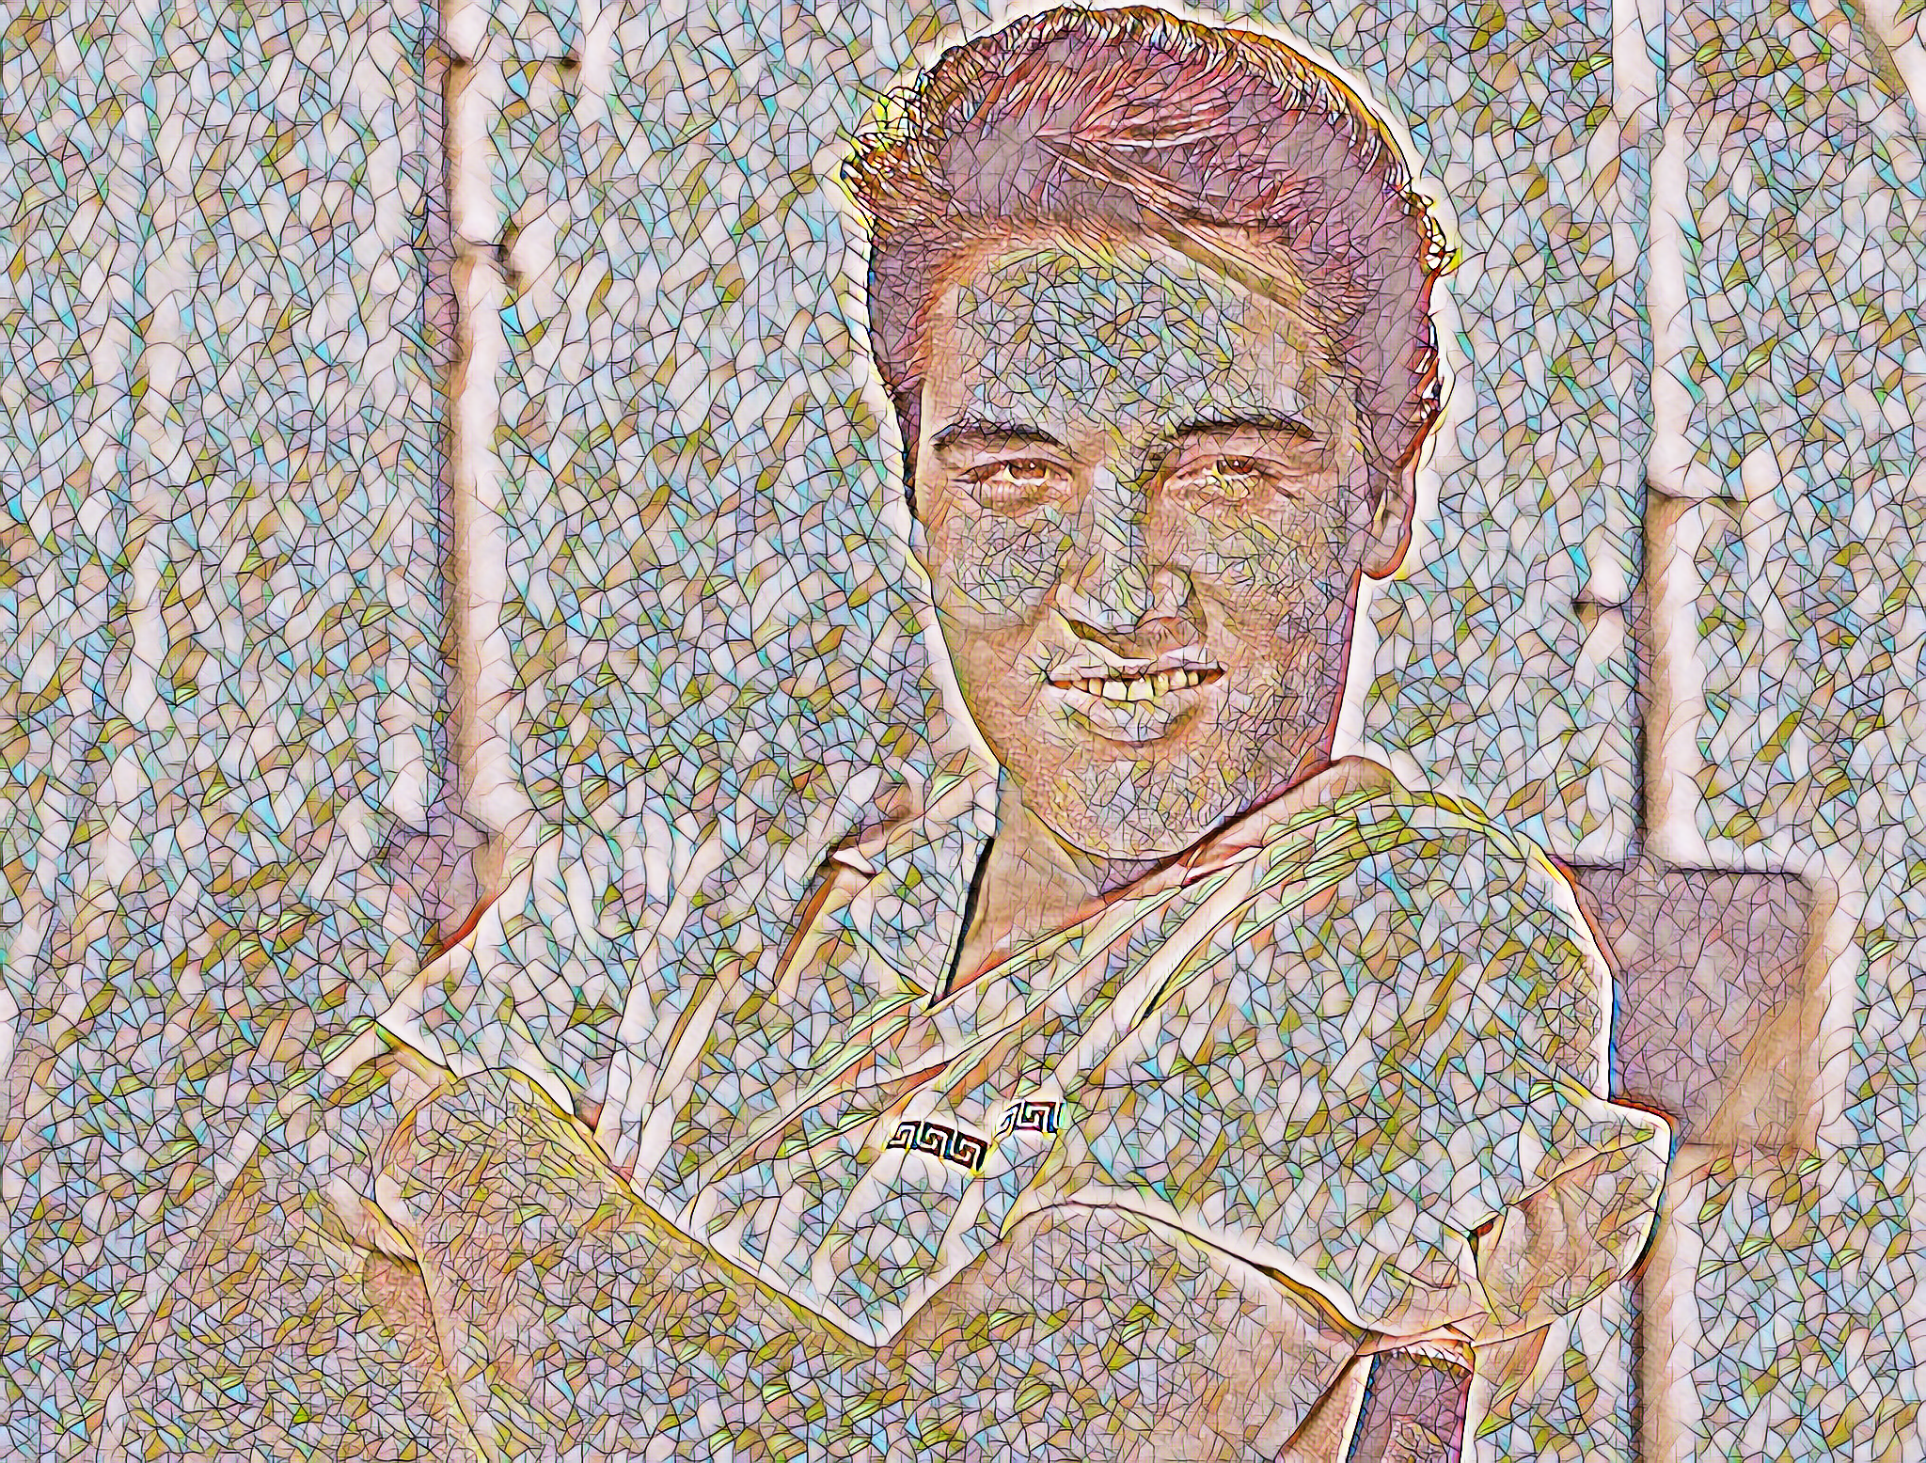
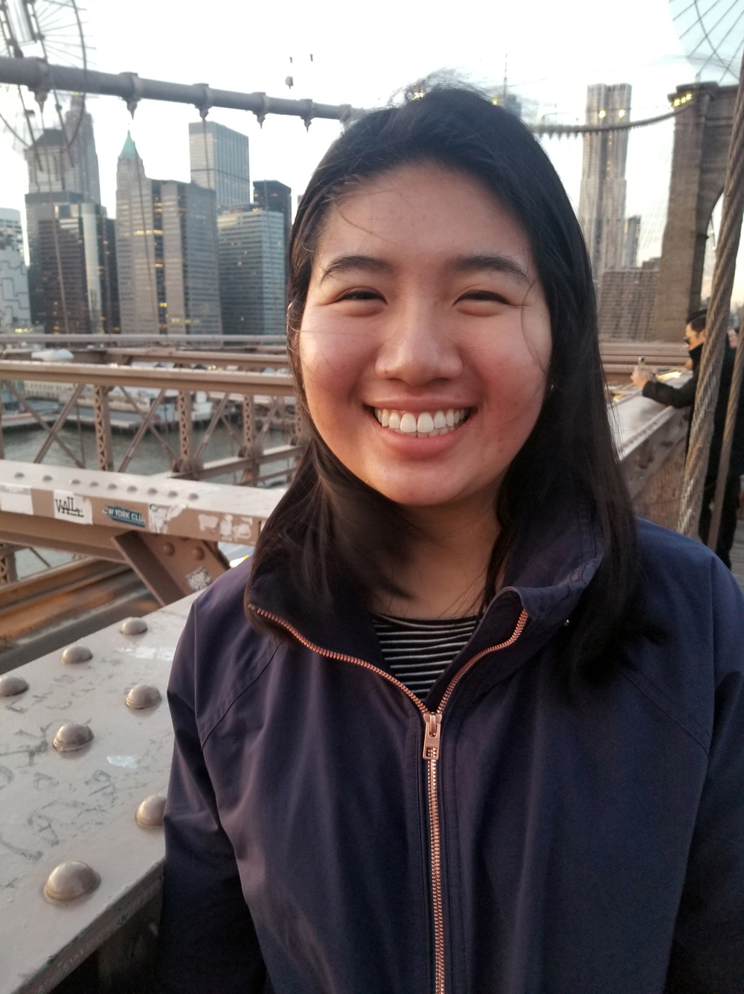
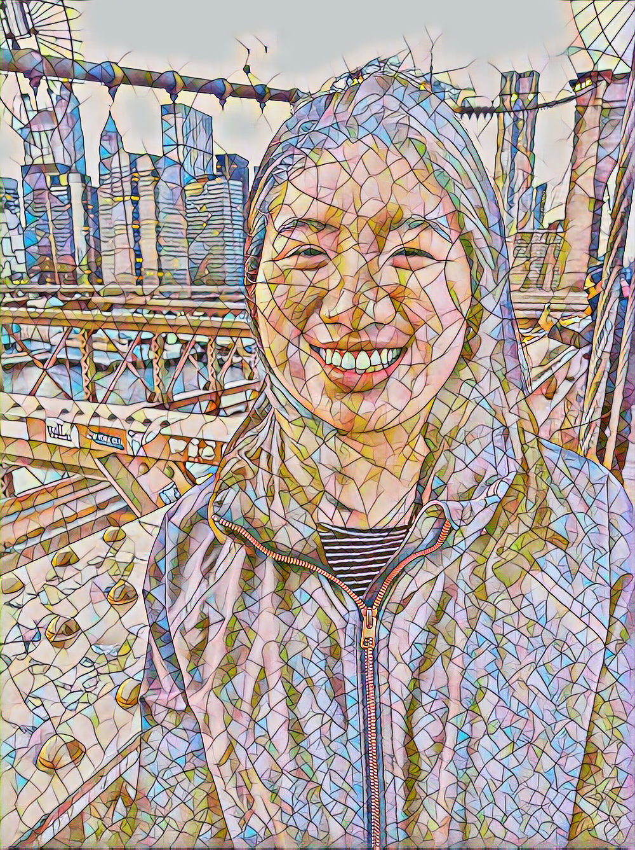
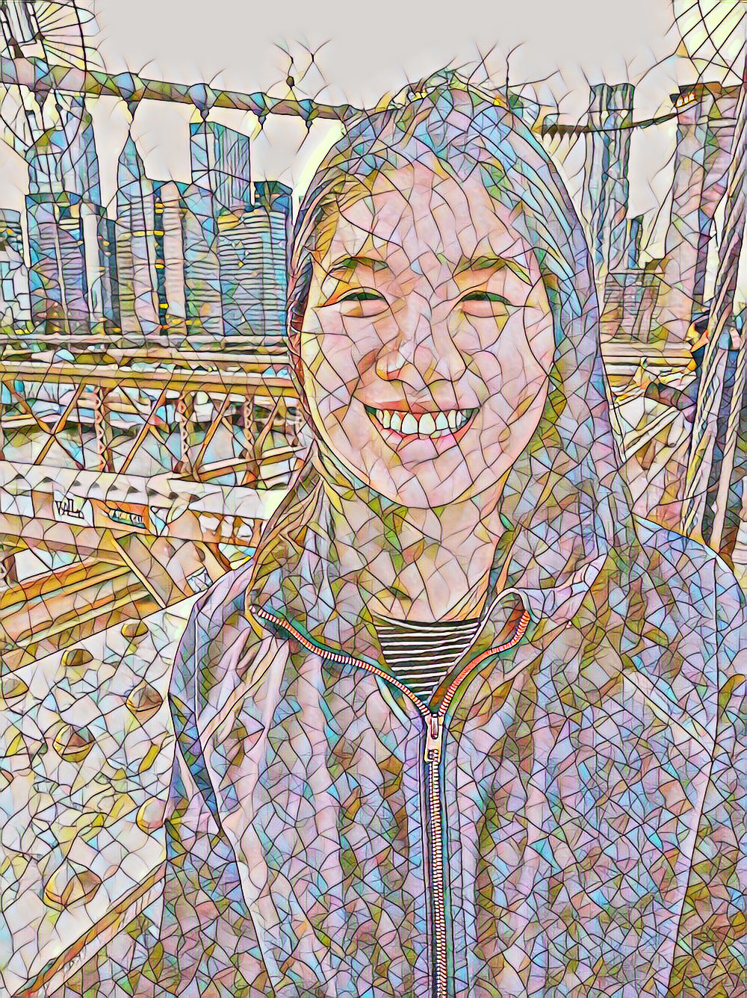

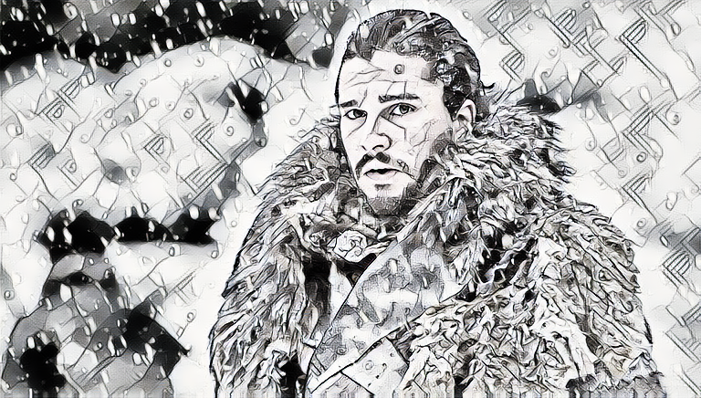
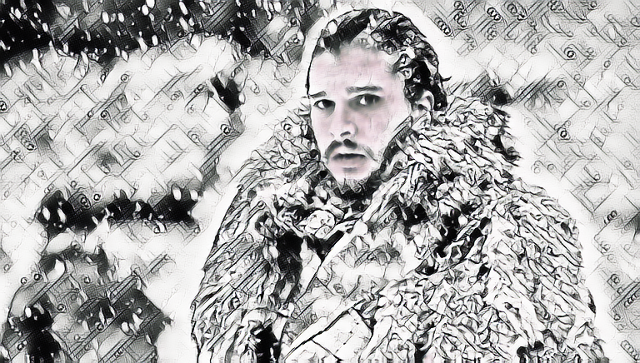
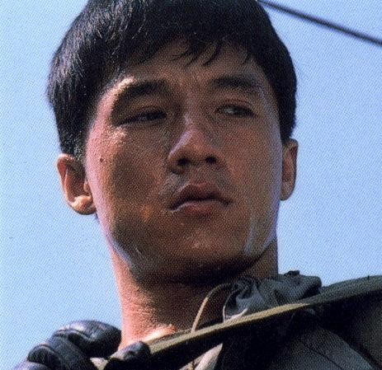
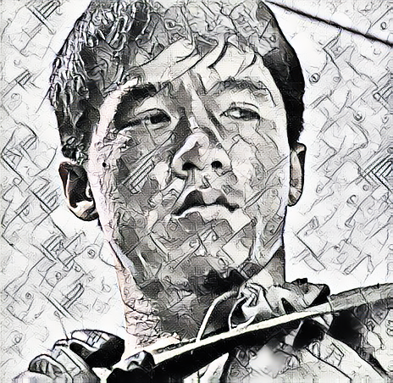
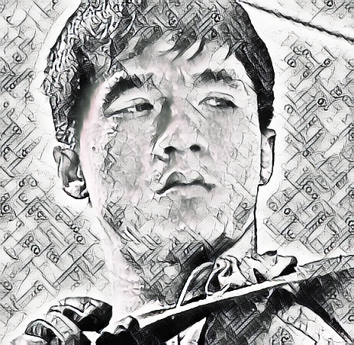
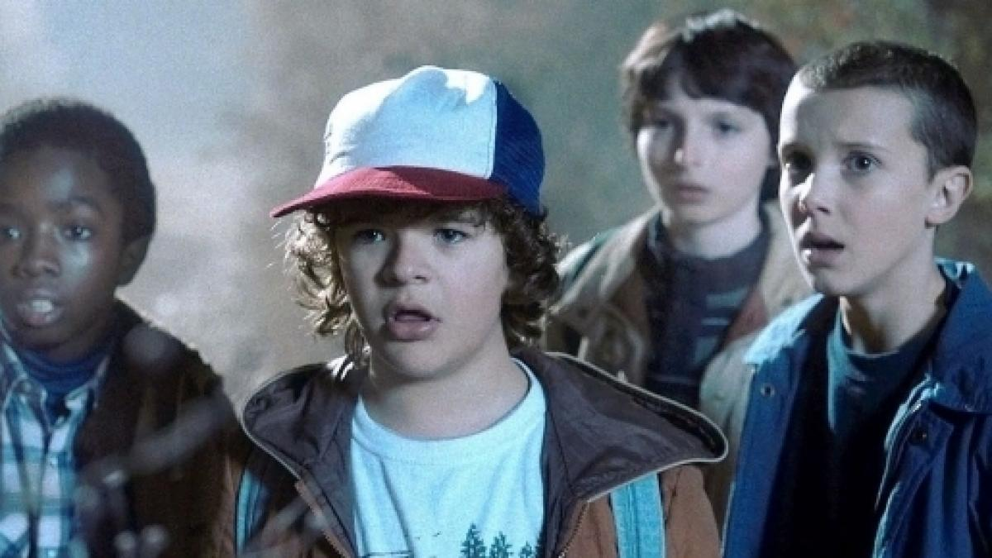
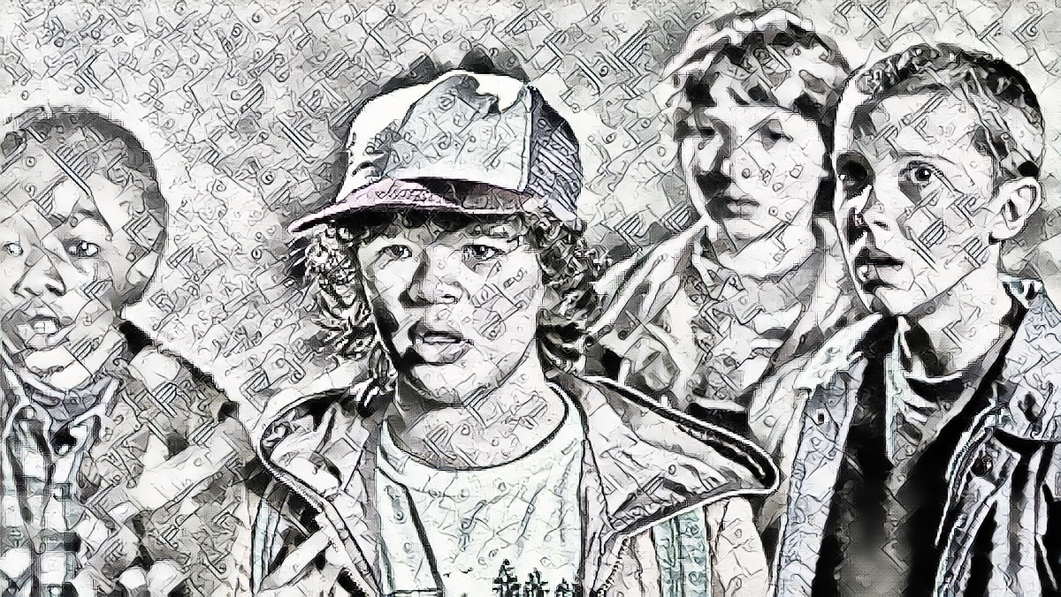
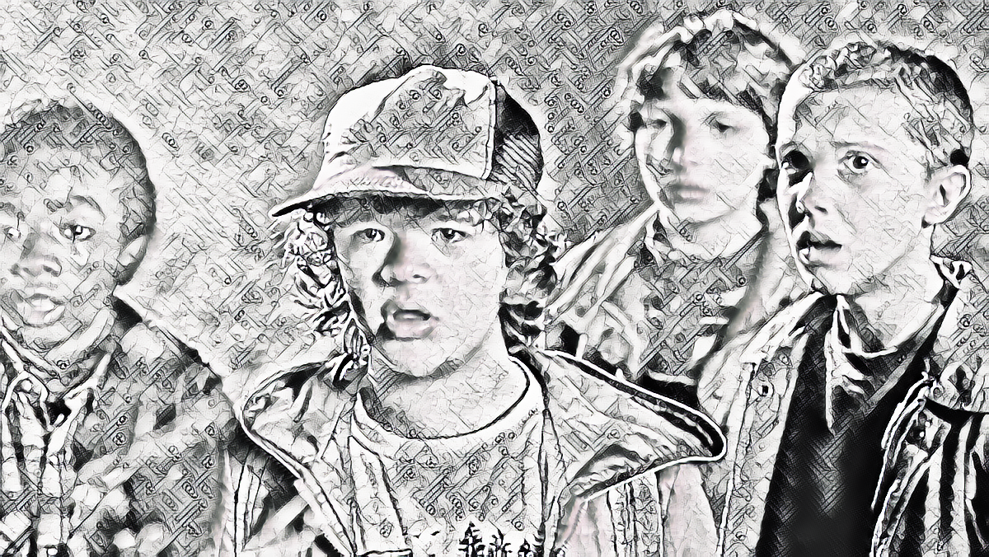
Results of Facial Preservation
Styles
Content
Without
With
Content
Without
With

Slide 8
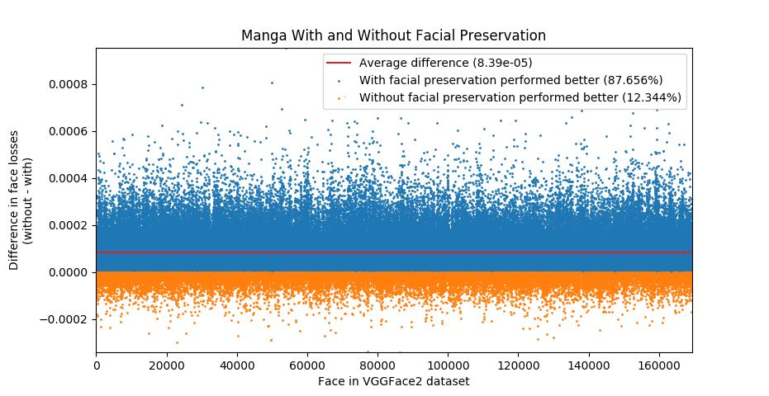
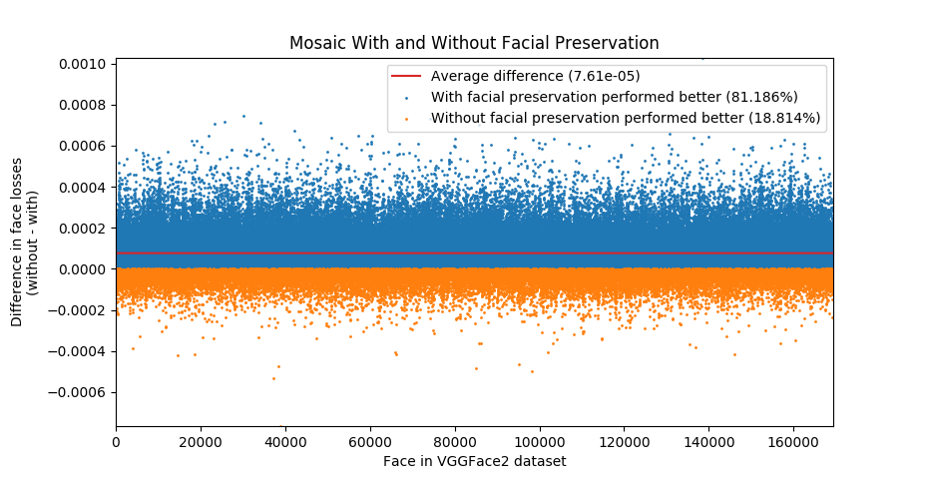
Quantitative Results
We can measure the results of facial preservation by computing the face loss over a face data set (VGGFace2)
Plot the difference between face loss with and without facial preservation

Slide 9
Limitation and Future Work
Others have extended Fast Neural Style Transfer to allow for multiple and arbitrary styles per trained model
Could improve the face preservation by using “attention” to focus the loss network on faces rather than general image classification
Face Attention Network: An Effective Face Detector for the Occluded Faces (Wang et al. 2017)
Training time is greatly increased with the addition of the face loss network
MTCNN and OpenFace slow the optimization loop
Train on a face dataset instead of a general image dataset

